Slide 1
RLAIF vs. RLHF: Scaling Reinforcement Learning from Human Feedback with AI Feedback Group 1 – Milestone 5

Slide 2
What is Feedback in Reinforcement Learning (RL)?
In Reinforcement Learning (RL), feedback is the reward or signal given to a model (agent) after it performs an action. This feedback tells the model how good or bad the action was, allowing it to learn and improve its behavior over time.
For Example: Training a Chatbot
User asks: “What’s a good way to handle stress?”
The chatbot gives two possible replies:
Response A: “Try deep breathing, regular exercise, and talking to someone you trust.”
Response B: “Just ignore it. Stress is for weak people.”
Here, Response A is helpful and polite.
Response B is toxic and unhelpful.
Through feedback (from a human or AI), the model is told that Response A is preferred.
Over time, the chatbot learns to generate more responses like A and avoid responses like B — thanks to the feedback loop.

Slide 3
Why Feedback is Important in Reinforcement Learning:
Teaches the Model What’s Right or Wrong Feedback acts as a signal to reinforce good behavior and discourage harmful or low-quality outputs.
Aligns the Model with Human or AI Preferences It helps the model generate responses that are more aligned with what people (or AI judges) expect—like politeness, clarity, and helpfulness.
Boosts Model Performance Beyond Data Feedback enables models to improve not just by learning patterns from data, but by understanding what kind of outputs are actually preferred.
Enables Detailed Behavioral Control Feedback allows developers to train models to follow specific goals—like being concise, avoiding bias, or sounding professional.
Serves as the Reward Signal in RL The model learns by maximizing the rewards it receives from feedback, much like a game player learns by scoring points.
Makes Learning Scalable with AI Feedback (RLAIF) Human feedback is powerful but expensive and slow. AI feedback (RLAIF) makes it faster and cheaper to scale training for large models.

Slide 4
Types of feedback
There are two main types of feedback
1. Human Feedback (RLHF)( Eg ChatGPT)
Feedback is given by real human annotators, who evaluate and compare the model’s responses to guide its learning.
For Example:
The model is prompted with:
"Respond to: 'You’re completely wrong and clearly clueless.’”
It gives two responses:
Response A: "Maybe you misunderstood my point. Let's try to clarify."
Response B: "No, you're just dumb and wrong.“
You show both responses to human evaluators and ask:
"Which response is better in tone and constructiveness?"
Humans choose Response A.

Slide 5
Types of feedback
2. AI Feedback (RLAIF) (Eg PaLM or GPT-4)
Feedback is generated by an off-the-shelf LLM (Language Model) instead of a human. The AI acts as a judge to decide which response is better.
Eg Model Output (Same Prompt):
"Respond to: 'You’re completely wrong and clearly clueless.'"
Model generates:
Response A: "Maybe you misunderstood my point. Let's try to clarify."
Response B: "No, you're just dumb and wrong.“
You prompt the LLM:
"Given these two responses, which one is more polite and less toxic? Please explain."
LLM replies:
"Response A is more polite and encourages a healthy discussion, while Response B is insulting and aggressive."
The AI chooses Response A.

Slide 6
INTRODUCTION
Reinforcement Learning from Human Feedback (RLHF) is a key method for aligning language
models with human preferences.
RLHF has been instrumental in the success of models like ChatGPT and Bard.
A major challenge of RLHF is its dependency on costly and time-consuming human feedback.
To address this, Reinforcement Learning from AI Feedback (RLAIF) was introduced.
RLAIF replaces human labels with preferences generated by off-the-shelf LLMs.
This paper compares the effectiveness of RLHF and RLAIF across three tasks:
Text Summarization
Helpful Dialogue Generation
Harmless Dialogue Generation
In fact, RLAIF outperforms RLHF in harmlessness, achieving an 88% harmless rate
(vs. RLHF’s 76% and SFT’s 64%).
A step further, the paper introduces direct-RLAIF (d-RLAIF), which bypasses training a reward model
by directly using AI-generated rewards during RL. d-RLAIF matches or exceeds canonical RLAIF performance.
The results suggest that RLAIF and d-RLAIF are viable, scalable alternatives to RLHF, especially when
human annotation is limited or costly.

Slide 7
how the RLAIF and d-RLAIF systems are implemented
This section outlines the key components of how the RLAIF and d-RLAIF systems are implemented, covering:
How is RL generated using an LLM?
How is RL applied?
And how performance is evaluated?

Slide 8
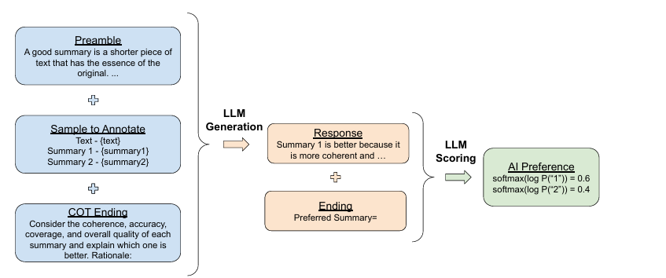
Preference Labeling with LLMs
To train a reward model without human feedback, preferences are generated using an off-the-shelf LLM (pre-trained or instruction-tuned but not fine-tuned for this specific task).
1. Prompt Construction
The LLM is prompted with:
Preamble- Introduction and instructions describing the task at hand
Few-shot exemplars (optional)- An example input con text, a pair of responses, a chain-of-thought rationale (optional), and a preference label
Sample to annotate- An input context and a pair of responses to be labeled
Ending- The ending text to prompt the LLM (e.g. “Preferred Response=”

Slide 9
Preference Labeling with LLMs
2. LLM Generation Phase
The LLM generates a reasoned response (COT-style), explaining which summary it prefers.
Example: “Summary 1 is better because it is more coherent and complete.”
This response is appended to the original prompt along with the final line:
"Preferred Summary=“ 3. LLM Scoring Phase
Next, the LLM is used to predict the likelihood of either "1" or "2" being selected.
It computes log probabilities of "1" and "2".
These are passed through a softmax function to get a preference distribution. Example:
softmax(log P("1")) = 0.6
softmax(log P("2")) = 0.4
This soft label gives more nuanced feedback than just picking one option (as in one-hot labels).

Slide 10
Mitigating Position Bias in LLM Preference Evaluation
Addressing Position Bias
Position bias is when the order of the responses influences the LLM’s decision.
For example, the model may favor the first option just because it's shown first—not because it's better.
What did the authors observe from the study?
Position bias is more prominent in smaller LLMs.
This bias can skew preference labels, reducing quality.
How do they fix it?
Two inferences are made per sample:
Present Summary 1 first, Summary 2 second.
Present Summary 2 first, Summary 1 second.
Final preference score is the average of both results.
This balances out any unfair advantage from position and makes scoring more reliable.

Slide 11
Enhancing Preference Labeling with Chain-of-Thought Reasoning
Eliciting Chain-of-Thought (CoT) Reasoning
CoT prompts encourage the LLM to explain its reasoning step-by-step.
This helps the model produce more thoughtful and accurate preference labels.
How does it work?
The standard prompt ending is replaced with an instruction asking for a detailed explanation:
“Consider the coherence, accuracy, coverage, and overall quality of each summary and explain which one is better. Rationale:”
The LLM responds with a justification (e.g., "Summary 1 is more coherent...").
That response is then combined with the original prompt and the standard ending:
“Preferred Summary=”
Finally, the model scores the options using its internal probability distributions (via softmax over tokens “1” and “2”).
This method not only gives better label quality but also improves alignment with human-like reasoning.

Slide 12
Reinforcement Learning from AI Feedback
Canonical RLAIF (Standard Setup)
How it works:
Train a Reward Model (RM):
The RM is trained on preference labels from an off-the-shelf LLM.
These preferences are soft labels (e.g., [0.6, 0.4] instead of [1, 0]).
RM training uses cross-entropy loss on the softmax scores.
This process is considered a form of model distillation—the RM learns from a more capable LLM.
Policy Training with RL:
Once the RM is trained, it is used to assign rewards to the model’s responses.
The policy (the model being trained) is updated through reinforcement learning using these rewards.
Summary: Canonical RLAIF relies on a trained reward model that distills LLM preferences and provides rewards during RL.

Slide 13
Direct-RLAIF (d-RLAIF):
Problem with Canonical RLAIF:
In canonical RLAIF, we use a Reward Model (RM) trained on AI-generated preferences to guide learning.
But here’s the catch:
As the policy model keeps improving, the type of outputs it generates change.
The Reward Model (RM) is trained only on older outputs from the initial version of the policy.
That means the RM doesn’t know how to judge the newer outputs, and its feedback becomes "stale" — less useful or even misleading.
Real-World Analogy:
Imagine a school teacher who graded only beginner-level essays.
Then later, students start writing advanced essays — but the teacher still uses the old rubric.
Result: The teacher gives bad grades to better answers because they don’t match the old format.
That’s exactly what happens when the Reward Model (RM) is not updated.

Slide 14
Detailed Process of d-RLAIF:
In d-RLAIF, we skip the Reward Model entirely and use the LLM directly during reinforcement learning to assign scores.
Step 1: Policy Model Generates Output
The current version of the policy model (e.g., chatbot) generates a response.
Step 2: LLM is Prompted to Rate
The LLM is given a prompt: “Rate this response from 1 to 10 based on helpfulness / accuracy / coherence...”
Step 3: LLM Returns a Score Distribution
The LLM doesn’t return a fixed score. Instead, it gives log-likelihoods of each score (from 1 to 10).
Example:
P(1) = 0.05
P(2) = 0.10
...
P(8) = 0.40
P(9) = 0.30
P(10) = 0.05

Slide 15
Detailed Process of d-RLAIF and Why d-RLAIF Is Better in Many Cases:
Issue | Canonical RLAIF | d-RLAIF
Stale Feedback | Yes (old RM) | No (uses live scoring)
Needs RM Training | Yes | No
Complex Setup | More complex | Simpler
Scoring Quality | Degrades over time | Always up-to-date
Computational Cost | Requires retraining RM | One-time LLM API calls
Step 4: Compute Weighted Score
A weighted sum is calculated:
s(y|x) = 10 i=1 iP(i|y,x),
Example: s(y∣x)=1×0.05+2×0.10+...+8×0.40+9×0.30+10×0.05=7.9
Step 5: Normalize the Score
This score is rescaled to the range [-1, 1] to be compatible with standard RL training.
Example: 7.9 → normalized to +0.78
Step 6: Use This Score as Reward in RL
The policy updates its parameters to generate more outputs like the ones that got high scores.

Slide 16
Evaluation Metrics
We evaluate using 3 key metrics:
1. AI Labeler Alignment
Measures how often AI preferences match human preferences
Convert soft label [0.6, 0.4] → [1, 0] → Compare with human label
Accuracy = % agreement
2. Win Rate
For two models (e.g., RLAIF vs. RLHF), we ask humans: “Which output is better?”
Win Rate = % of times one model is preferred
3. Harmless Rate
% of outputs considered safe (non-toxic)
Especially used for harmless dialogue tasks
No ranking – just “harmless or not”

Slide 17
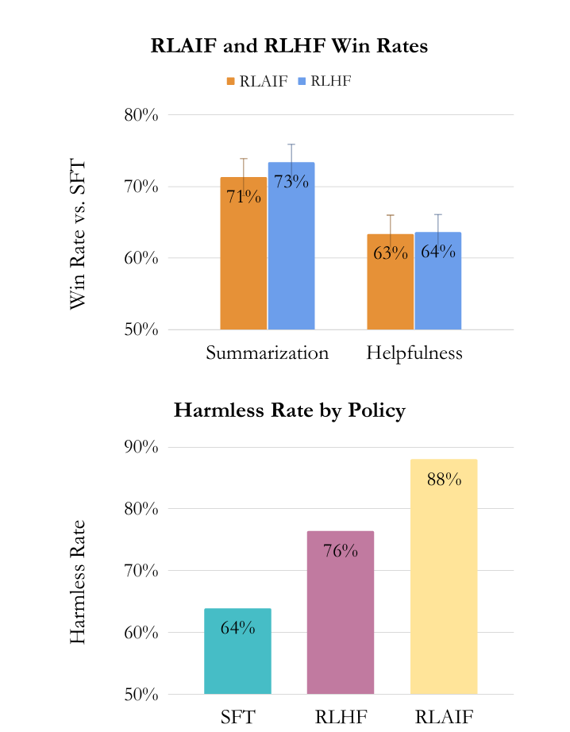
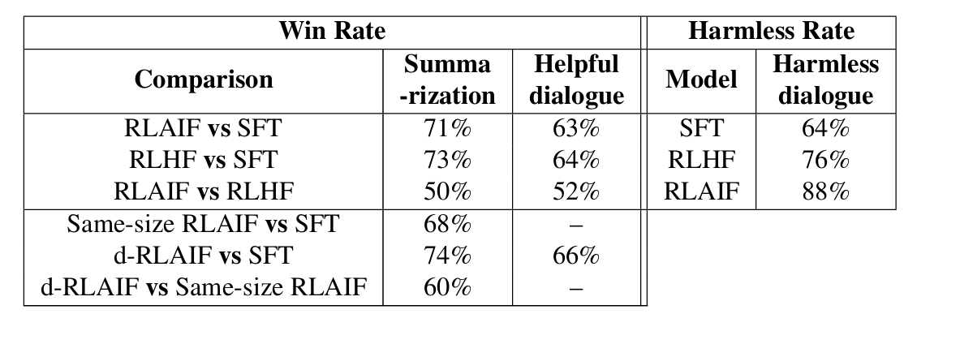
Experimental results: RLHF VS RLAIF

Slide 18
Experimental results: RLHF VS RLAIF
RLAIF performs comparably to or better than RLHF across all three tasks (summarization, helpful dialogue, and harmless dialogue), with similar win rates over the SFT baseline:
Summarization: RLAIF 71%, RLHF 73%
Helpful Dialogue: RLAIF 63%, RLHF 64%
The win rate difference between RLAIF and RLHF is not statistically significant, meaning both are equally preferred by human annotators when compared directly.
For harmless dialogue, RLAIF achieves the highest harmlessness rate at 88%, outperforming both RLHF (76%) and SFT (64%), indicating better safety alignment.
Both RLAIF and RLHF tend to generate longer responses than SFT, which may bias human evaluations. Even after controlling for response length, RLAIF and RLHF still outperform SFT.
Combining human and AI feedback in training did not improve performance beyond using human feedback alone, though other hybrid methods might still show potential (see Appendix K).
RLAIF offers a cost-effective and scalable alternative to RLHF by eliminating the need for human labels, reducing feedback costs by over 10x compared to human annotation

Slide 19
Direct RLAIF (d-RLAIF)
d-RLAIF (direct preference learning) was tested on summarization and helpfulness tasks using the smaller, instruction-tuned PaLM 2 XS model as the AI labeler to reduce compute costs.
In summarization, human annotators preferred d-RLAIF over SFT (Supervised Fine-Tuning) 74% of the time, showing strong performance.
When compared to same-size RLAIF (which uses a Reward Model distilled from LLM feedback), d-RLAIF had a higher win rate (74% vs. 68%), showing statistically significant improvement.
Annotators also preferred d-RLAIF over RLAIF 60% of the time, suggesting that directly using LLM preferences is more effective than relying on a reward model.
The likely reason for d-RLAIF's superiority is that it avoids the "staleness" problem—reward models may become outdated or misaligned during training.
In the helpful dialogue generation task, d-RLAIF achieved a 66% win rate over the SFT baseline, demonstrating an example of LLM self-improvement, as the model giving feedback and the policy being trained were the same.

Slide 20
AI Labeler Alignment by Prompt Type
Chain-of-Thought (CoT) reasoning improves AI labeler alignment, especially for summarization tasks, and helps with helpful/harmless dialogue only when used with the Base prompt.
Detailed preambles boost alignment in summarization, but show mixed results for helpfulness and harmlessness, likely due to the simplicity of these tasks.
In-context learning (few-shot prompting) only helps with harmlessness; for summarization and helpfulness, alignment decreases as the number of examples increases.
The best AI alignment score (78.0%) came from the Detailed + CoT 0-shot prompt, even outperforming estimated human inter-annotator agreement (73–77%).
Self-consistency, which samples multiple CoT rationales, degrades alignment, contrary to expectations.
Training RLAIF policies with better-aligned AI labels leads to higher performance, suggesting a direct link between label quality and policy effectiveness.

Slide 21
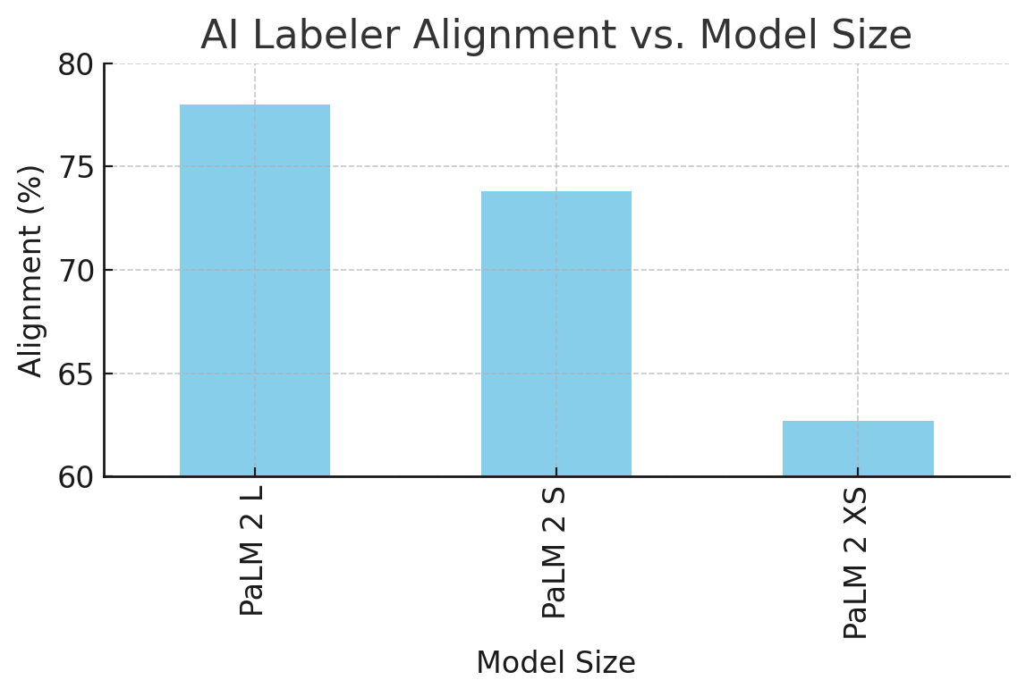
AI Labeler Alignment vs. Model Size
This chart shows that as the LLM model size increases, the alignment with human preferences also improves:
PaLM 2 L achieves the highest alignment at 78.0%.
PaLM 2 S drops to 73.8%, and PaLM 2 XS further down to 62.7%.
Let me know if you’d like these added to your presentation slides.

Slide 22
Qualitative Observations
Similarity in Outputs: In many test cases, RLAIF and RLHF generated similar summaries, reflecting their comparable win rates.
RLHF Hallucinations: RLHF occasionally hallucinated details not present in the original text. Example: RLHF summary stated the author is 20 years old, though the source never mentioned it.
RLAIF Repetition Issues: Some RLAIF summaries had repeated phrases or less fluent structure, such as unnecessary repetition like “How do I get over this?”.
Fluency Trade-Off: RLHF responses were more fluent but sometimes less grounded, while RLAIF was more factual but occasionally less polished.
Human Evaluation: A blind ranking by humans on 70 examples showed no statistically significant difference between RLHF and RLAIF in terms of:
Accuracy
Coverage
Coherence

Slide 23
Conclusion
RLAIF Matches RLHF: RLAIF provides comparable or better results than RLHF across summarization, helpfulness, and harmlessness tasks.
RLAIF is Scalable & Cost-Effective: It reduces the need for expensive human labeling by using LLM-generated feedback, cutting costs 10x cheaper.
d-RLAIF Outperforms Canonical RLAIF: Directly using LLM feedback during RL removes the need for training a reward model and avoids RM staleness.
Prompt Engineering Matters:
Chain-of-Thought (CoT) reasoning improves alignment.
Detailed preambles work best for complex tasks like summarization.
In-context learning has mixed effects.
LLM Size Matters:
Larger models = better alignment with human preferences.
But even same-size models can self-improve under RLAIF!
Open Questions Remain:
How can RLAIF be applied in model-based RL settings?
Can AI + human feedback combination yield better results?

Slide 24
Appendix
🧪 3. Experimental Details
📚 3.1. Datasets Used
Reddit TL;DR: Contains Reddit posts and their summaries.
OpenAI’s Human Preferences: A subset of Reddit TL;DR with human-annotated preferred summaries.
Anthropic Human Preferences: Human vs AI conversations with ratings for helpfulness and harmlessness.
Tried Stanford Human Preferences, but no major gains seen after correcting bias.

Slide 25
Appendix
3.2. LLM Labeling
Used PaLM 2 (Large) models for labeling AI preferences.
Summarization examples were filtered to only include high-confidence human preferences.
Around 3-4k examples per task used after filtering.
Labels were generated using the best-performing prompts.

Slide 26
Appendix
⚙️ 3.3. Model Training
SFT Models: Initialized from PaLM 2 Extra-Small (XS).
For summarization: Fine-tuned on Reddit TL;DR.
Reward Models (RM): Also based on PaLM 2 XS.
RL Phase: Used a simplified version of REINFORCE algorithm (instead of PPO) to train policy models.
Policies were trained on:
Reddit TL;DR for summarization
Anthropic datasets for helpful/harmless dialogue

Slide 27
Appendix
👨‍⚖️ 3.4. Human Evaluation
Human evaluators ranked responses from different models (SFT, RLAIF, RLHF).
For harmlessness, each response was marked as either "harmless" or "harmful".
Used test split data to ensure fair evaluation (not seen during training)

